Slide 1

Chinook Music Analysis
:- Vinay Prakash.n
(Data Analytics)

Slide 2

About The Group
Chinnok Music Group 2009 - 2013 are Sales the Musical Instruments And they Sales around the Countries and the More sales. The Group are diverse range of cater to Various preference and needs.
Started in 2001
Our People
Executive Team
with 2000+ Employees
Chinnok Music
Groups
Why We Started
. Pass for Musical Inustruments
. Market Opportunity
. Vision for Growth

Slide 3

Statement
Problem Statement
. They are Difficulty to find the Longest Track and also the Top 5 Customers Details and Sales Details
Total Sales which has done by the Countries wised in the Billing.

Slide 4

DATABASE:-
TABLES
. Employee
. Customer
. Invoice
. Invoiceline
. Album
. Artist
. Genre
. Track
. Playlist Track
. Playlist
. Mediatype

Slide 5
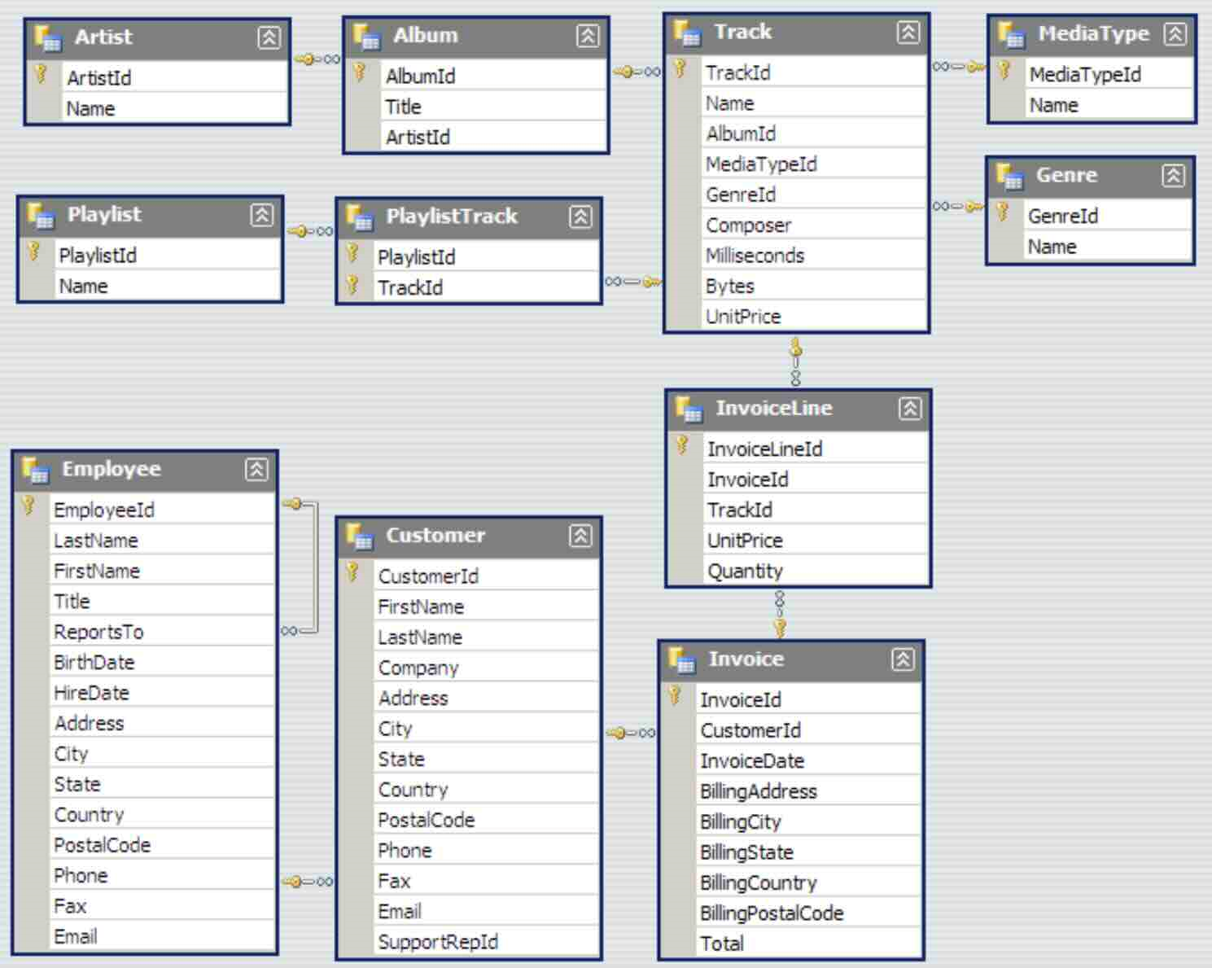

Slide 6

Retriving Data From Different Tables
MUSIC CHINOOK
Employee, customer, invoice, Invoiceline, album, Artist, genre, track, playlist track, playlist, mediatype.
By query

Slide 7
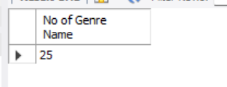
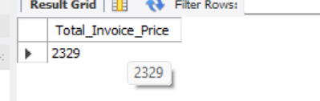
1. Find the Number of the Genre Name in the Genre Table
SELECT
COUNT(name) 'No of Genre Name’
FROM
genre;
2. Find the SUM of invoice
SELECT
ROUND(SUM(total), 0) AS Total_Invoice_Price
FROM
invoice;

Slide 8
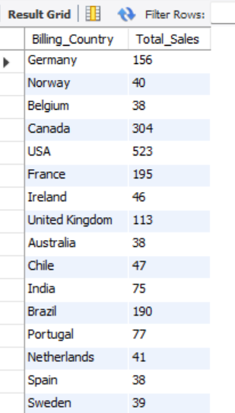
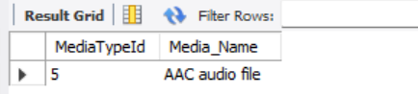
3. Find the Latest Name of the Media from the MediaType
SELECT
MediaTypeId, name AS Media_Name
FROM
mediatype
ORDER BY MediaTypeId DESC
LIMIT 1;
4.
4. Find the Billing Countries and the Total Sales of it.
SELECT
billingcountry AS Billing_Country,
ROUND(SUM(total), 0) AS Total_Sales
FROM
invoice
GROUP BY billingcountry;

Slide 9
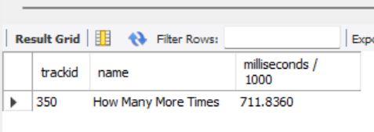
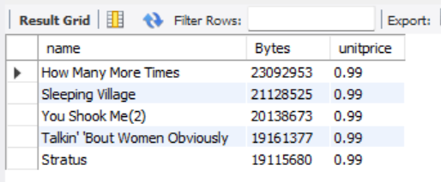
5. find the largest Track in the Database
SELECT
trackid, name, milliseconds / 1000
FROM
track
ORDER BY milliseconds DESC
LIMIT 1;
6. Find the Top 5 most Bytes in Track
SELECT
name, Bytes, unitprice
FROM
track
ORDER BY bytes DESC
LIMIT 5;

Slide 10
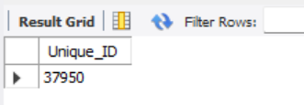
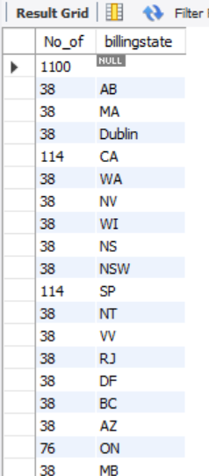
7. Find the Number of Quantity are Bill for an State
SELECT
COUNT(quantity) AS No_of, billingstate
FROM
invoiceline
JOIN
invoice ON invoiceline.invoiceid = invoice.invoiceid
GROUP BY billingstate;
8. Write a Query to Display Total Number of the unique ID for Artist
SELECT
SUM(DISTINCT (artistid)) AS Unique_ID
FROM
artist;

Slide 11
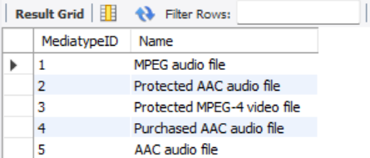
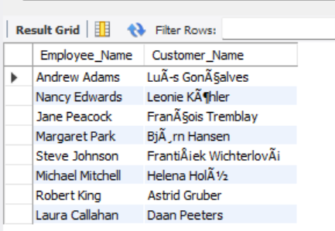
9. Write a Query to Display Name and MediaType_ID for the MediaType
SELECT
MediatypeID, Name
FROM
mediatype;
10. Write a Query to Display Employees with Customers
SELECT
CONCAT(employee.firstname,
' ',
employee.lastname) AS Employee_Name, CONCAT(customer.firstname,
' ',
customer.lastname) AS Customer_Name
FROM
employee
JOIN
customer ON employee.employeeId = customer.customerId;

Slide 12
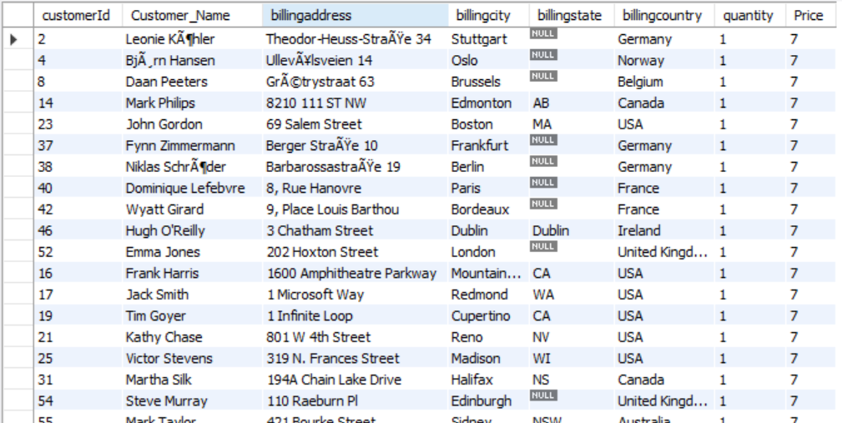
11. Write a Query to Display all Billing Detail from Invoice Table and the Customers from Customer table and also Price from the Invoiceline table
SELECT
customer.customerId,
CONCAT(customer.firstname,
' ',
customer.lastname) AS Customer_Name, billingaddress, billingcity, billingstate, billingcountry, quantity,
ROUND(SUM(invoiceline.unitprice)) AS Price
FROM
customer
RIGHT JOIN
invoice ON Customer.customerid = invoice.customerid JOIN
invoiceline ON invoice.invoiceid = invoiceline.invoicelineid
GROUP BY
customer.customerid , CONCAT(customer.firstname, ' ‘,
customer.lastname) , billingaddress , billingcity , billingstate , billingcountry , quantity;

Slide 13
12. Write a Query to Display Trigger After Inserting value from invoice
DELIMITER //
CREATE TRIGGER after_invoice_insert
AFTER INSERT ON Invoice
FOR EACH ROW
BEGIN
INSERT INTO InvoiceLog (InvoiceId, LogDate)
VALUES (NEW.InvoiceId, NOW());
END //
DELIMITER ;
13. Write a Query to Display Trigger Before Inserting value from invoice
DELIMITER //
CREATE TRIGGER before_invoice_insert
BEFORE INSERT ON Invoice
FOR EACH ROW
BEGIN
IF NEW.Total IS NULL THEN
SET NEW.Total = 0;
END IF;
END //
DELIMITER ;

Slide 14
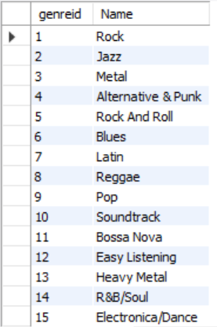
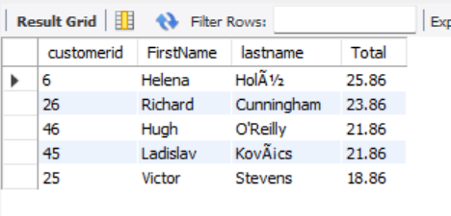
14. Write a Query to create an Views from Genre Name
create View Genre_details as
select genreid, Name from Genre;
For to Check View Table
SELECT *FROM genre_details;
15. find the Top 5 Customers Who Spend the Most Money in the Store
SELECT
customer.customerid, customer.FirstName, customer.lastname, invoice.Total
FROM
customer
JOIN
invoice ON customer.CustomerId = invoice.CustomerId
ORDER BY invoice.total
DESC
LIMIT 5;

Slide 15
Over All View
DAsHBOARD OF THE CHINOOK MUSIC ANALYSIS

Slide 16
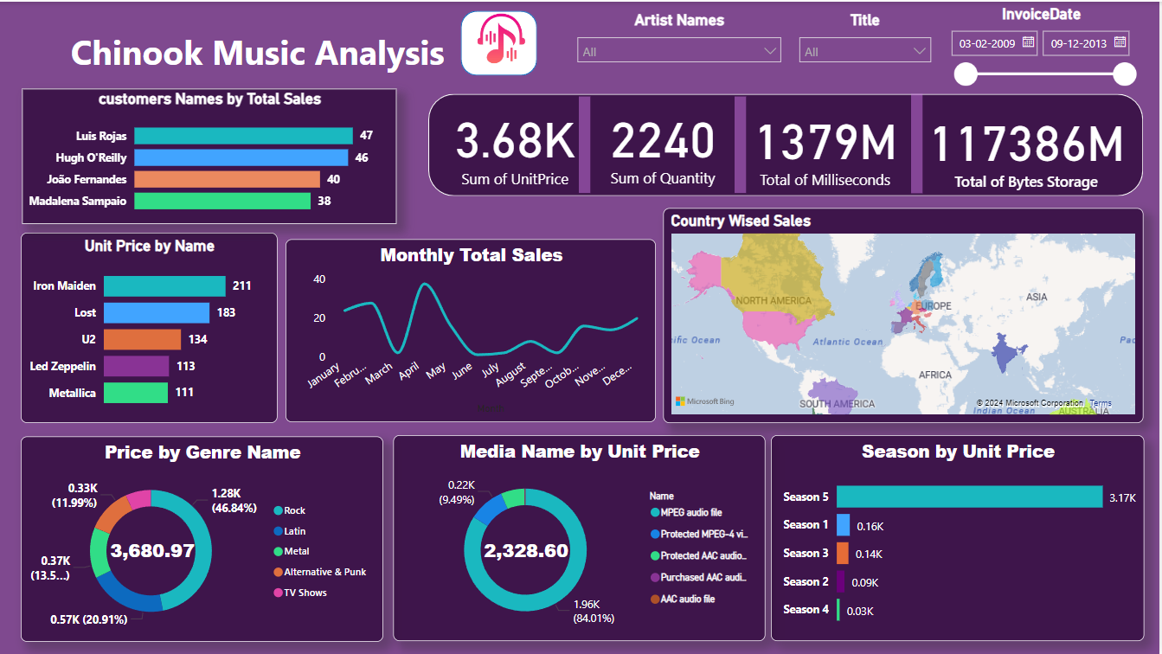

Slide 17

THANK YOU
:- Vinay Prakash.N
(Data Analytics)

